Slide 1

Chapter 26
Remote Logging,
Electronic Mail,
and File Transfer
26.<number>
Copyright © The McGraw-Hill Companies, Inc. Permission required for reproduction or display.

Slide 2
26-1 REMOTE LOGGING
It would be impossible to write a specific client/server program for each demand. The better solution is a general-purpose client/server program that lets a user access any application program on a remote computer.
Topics discussed in this section:
TELNET
26.<number>

Slide 3
TELNET
Stands for Terminal Network.
Standard TCP/IP protocol for virtual terminal service as proposed by the International Organization for Standards (ISO).
TELNET enables the establishment of a connection to a remote system in such a way the local terminal appears to be a terminal at the remote system.
26.<number>

Slide 4

Note
TELNET is a general-purpose client/server application program.
26.<number>

Slide 5
Time sharing environment
TELNET was designed in the era of Operating systems working in time sharing environment.
In such environment, a large computer supports multiple users.
The interaction between a user and the computer occurs through a terminal.
Terminal???
  It is a combination of keyboard, monitor and mouse.
  A microcomputer can simulate a terminal with a terminal emulator.
26.<number>

Slide 6
logging
Local Log-in
  TELNET is not used
Remote Log-in
  TELNET is used
26.<number>

Slide 7
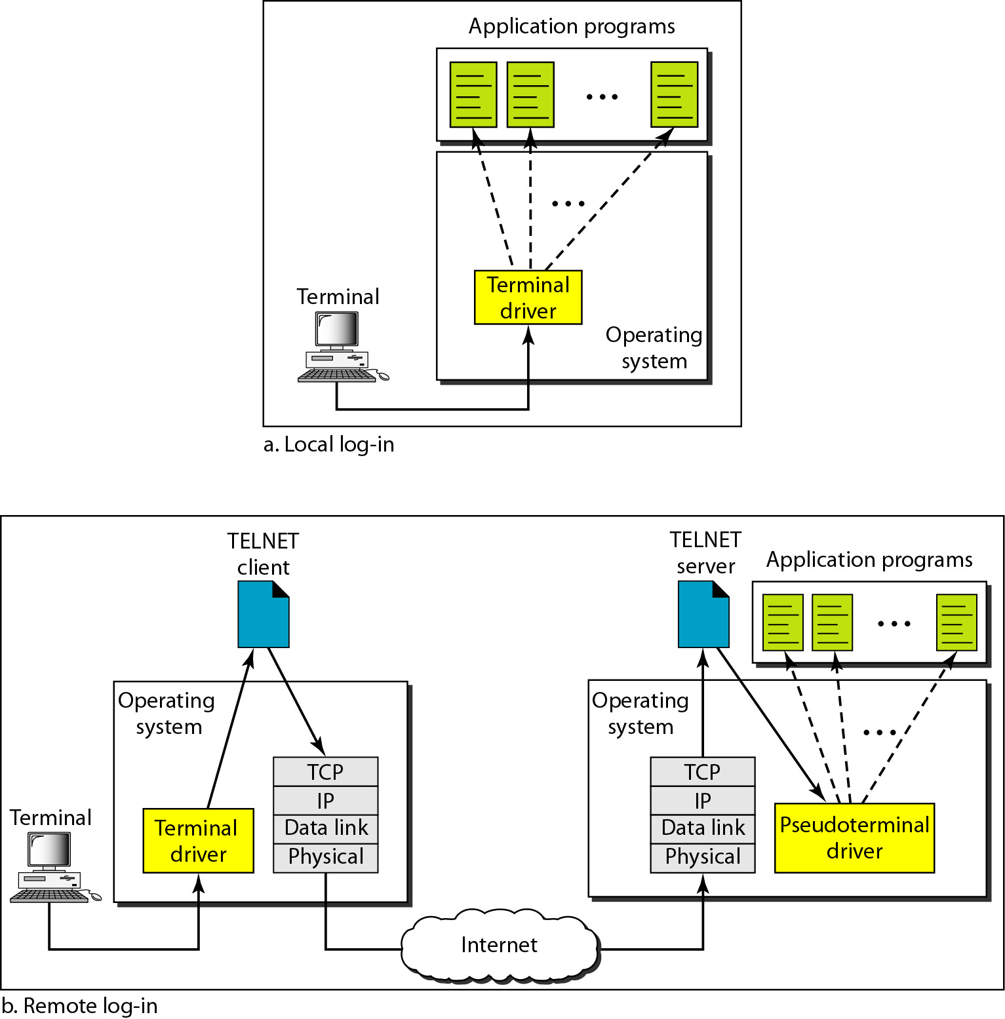
Figure 26.1 Local and remote log-in
26.<number>

Slide 8
26-2 ELECTRONIC MAIL
One of the most popular Internet services is electronic mail (e-mail). The designers of the Internet probably never imagined the popularity of this application program. Its architecture consists of several components that we discuss in this chapter.
Topics discussed in this section:
Architecture
User Agent
Message Transfer Agent: SMTP
Message Access Agent: POP and IMAP
Web-Based Mail
26.<number>

Slide 9
Architecture
An e-mail system is composed of following components:
  User agent
  Mail transfer agent
  Mail access agent
26.<number>

Slide 10
User Agent
This is the first component of an electronic mail system.
Provides services to the use to make the process of sending and receiving a message easier.
In short a user agent is a software package (program) that composes, reads, replies to, and forwards messages.
It also handles mailboxes.
26.<number>

Slide 11
User Agent Types
There are two types of user agents:
  Command-driven
    Belongs to early days of electronic mail
    Still present in servers
  GUI based
    Currently available electronic mail systems
26.<number>

Slide 12

Figure 26.11 Services of user agent
26.<number>

Slide 13
Note
Some examples of command-driven user agents are mail, pine,
and elm.
26.<number>

Slide 14
Note
Some examples of GUI-based user agents are Eudora, Outlook, and Netscape.
26.<number>

Slide 15

Figure 26.12 Format of an e-mail
26.<number>

Slide 16

Figure 26.13 E-mail address
26.<number>

Slide 17
MIME
Multi-purpose internet mail extensions.
E-mail has a simple structure with limitation.
The messages can only be sent in NVT 7bit ASCII format.
We cannot mail in languages supporting more the 7 bit characters.
  E.g. french, german, japanese etc…
MIME is a supplementary protocol that allows non-ASCII data to be sent through e-mail.
NOTE: NVT(Network virtual terminal) is a universal character set.
26.<number>

Slide 18
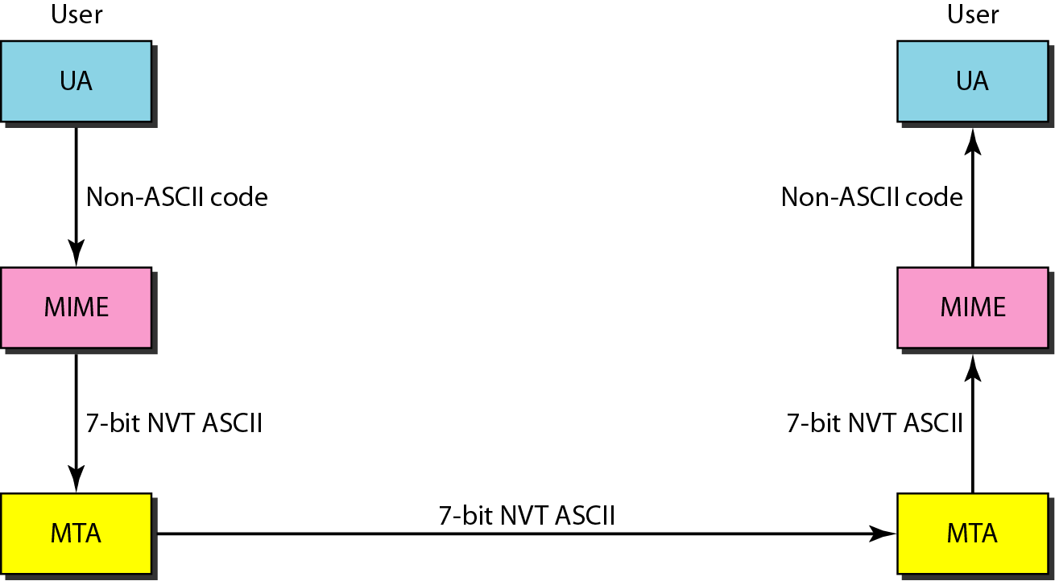
Figure 26.14 MIME
26.<number>

Slide 19
Mail Transfer Agent
For transferring mail, we need mail transfer agents.
The protocol used is: SMTP
26.<number>

Slide 20
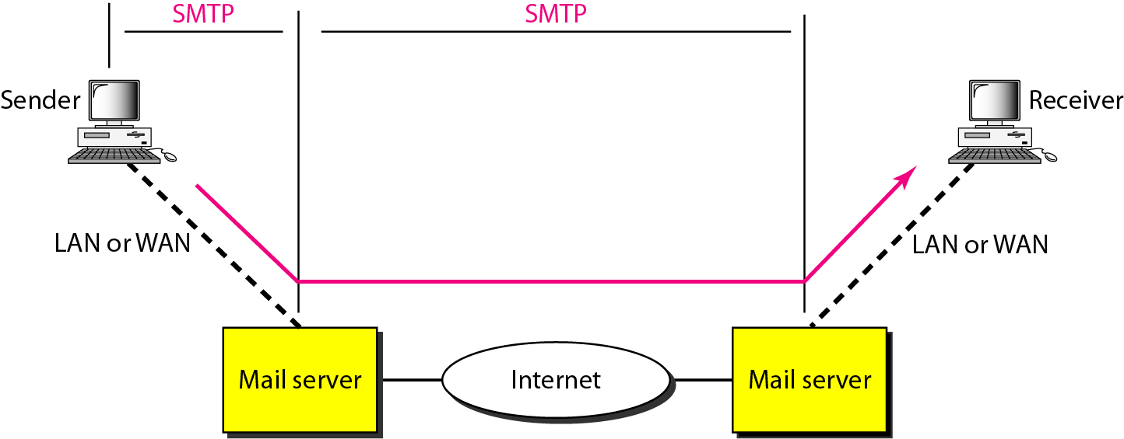
Figure 26.16 SMTP range
26.<number>

Slide 21

Figure 26.17 Commands and responses
26.<number>

Slide 22
Message Access Agent
Used by the client to access mail
Protocol used: IMAP, POP3
26.<number>

Slide 23
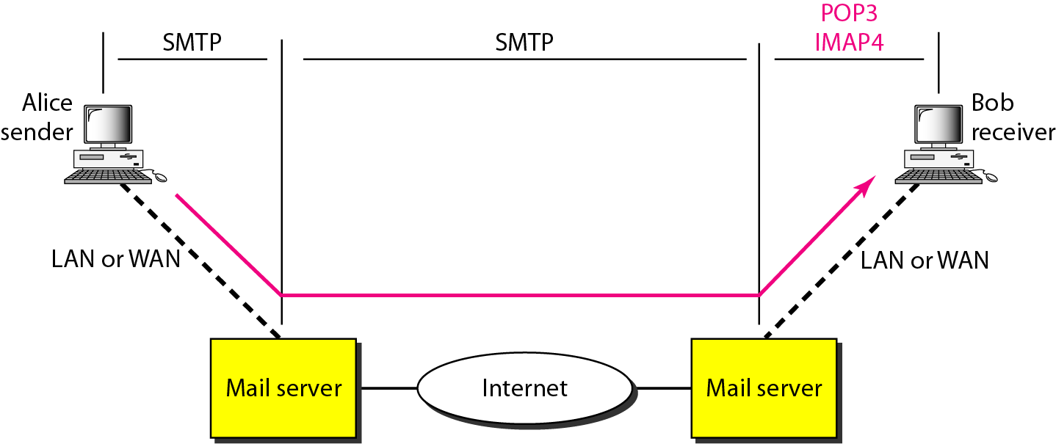
Figure 26.19 POP3 and IMAP4
26.<number>

Slide 24
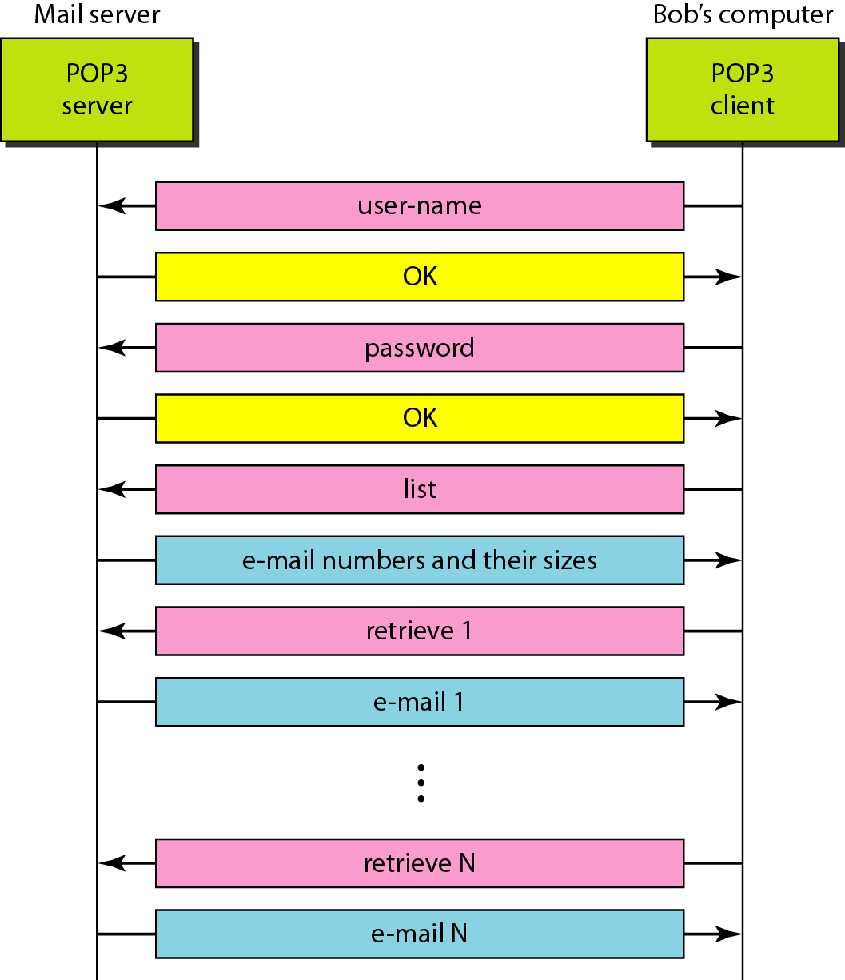
Figure 26.20 The exchange of commands and responses in POP3
26.<number>

Slide 25
26-3 FILE TRANSFER
Transferring files from one computer to another is one of the most common tasks expected from a networking or internetworking environment. As a matter of fact, the greatest volume of data exchange in the Internet today is due to file transfer.
Topics discussed in this section:
File Transfer Protocol (FTP)
Anonymous FTP
26.<number>

Slide 26
Note
FTP uses the services of TCP. It needs two TCP connections.
The well-known port 21 is used for the control connection and the well-known port 20 for the data connection.
26.<number>

Slide 27
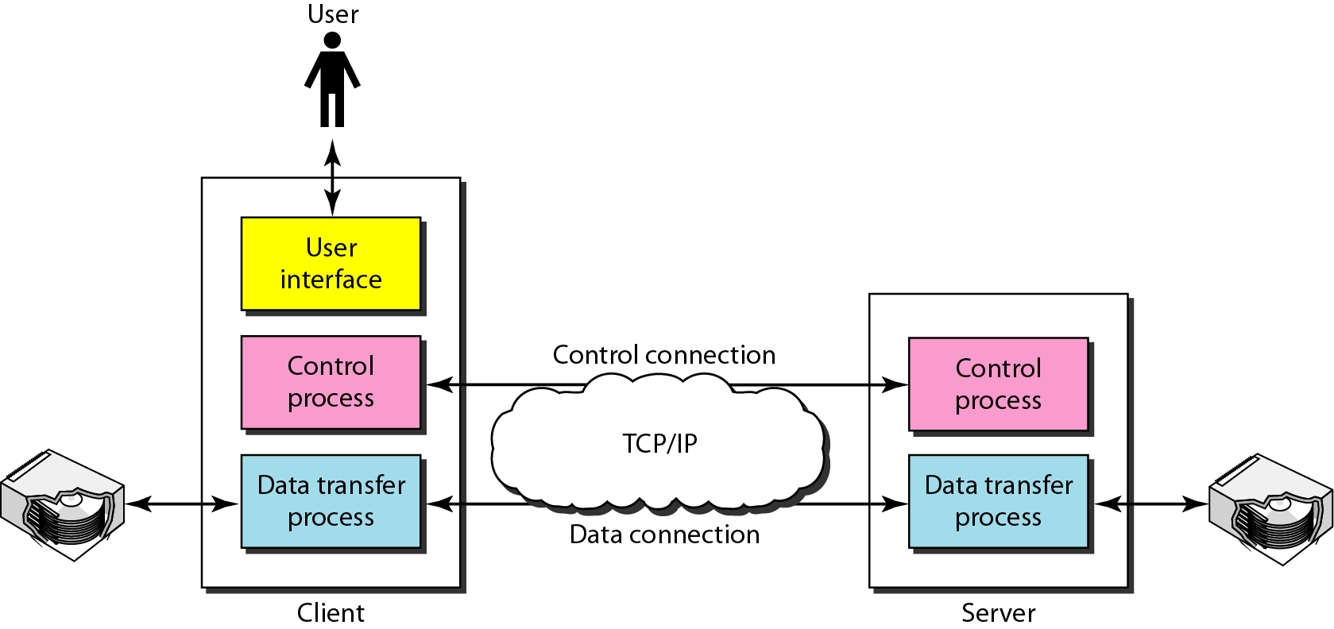
Figure 26.21 FTP
26.<number>

